Slide 1


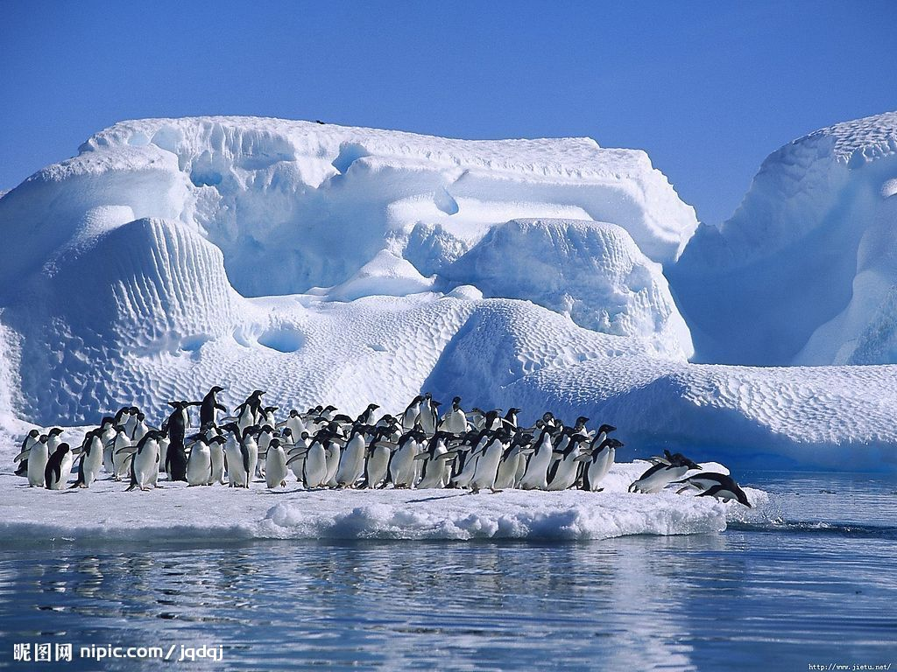

高中第八册
Module 1
Deep South

Slide 2
Language Points

Slide 3
1. With annual rainfall close to zero, Antarctica is technically a desert.
南极洲年降雨量几乎为零，严格来说该区域就是一片荒漠。
with annual rainfall close to zero 为介词短语，表示原因，由介词＋名词＋形容词（词组）组成，也即“with +宾语＋形容词短语”构成的复合结构。例如：

Slide 4
With so many students weak in their pronunciation, they started from the beginning.
He sat there quietly with mouth half open, listening to the radio.
He sat there with his eyes ________(fix) on the sky.
fixed
He sat there with his hand ________ (point) at me.
pointing
He went to the classroom with a lot of homework _____.
to do

Slide 5

2. Covering about 14 million square kilometers around the South Pole, it is the fifth largest continent in the world.
南极洲覆盖了南极圈周围1,400万平方公里的面积，是世界第五大洲。
1) covering about…在句子中作状语。

Slide 6
2) the fifth largest continent in the world. 形容词最高级前面的修饰成分为序数词。
Is it the third longest river in the world?
形容词最高级前面还可有其他的成分。
It was by far the best university I have visited.
It was of the very highest quality.

Slide 7
3. On average it is two kilometers thick, but in some places it reaches a depth of five kilometers.
(南极洲)冰层平均厚度为2，000米，但某些地方厚度可以达到5，000米。

Slide 8
词组two kilometers thick，形容词thick 增加了修饰成分 two kilometers。例如：
The rope is two meters long.
The well is 12 meters deep.
但是注意下面情况：
It is a 12-meter-long rope.
The 12-meter-deep well is the deepest one in our village.

Slide 9
4. As a result, it has become a window on the past, and can give researchers lots of useful information.
因此，它已经变成人们了解过去的窗口，可为研究者提供大量有用的信息。
window 窗户，窗口 在此引申为“获得信息的渠道” 。
International news broadcasts provide a window on the world.

Slide 10
5. But the long Antarctic winter night, which lasts for 182 days (the longest period of continuous darkness on the earth ) as well as the extreme cold and lack of rainfall, means that few types of plants can survive there.
但是南极洲冬天的夜晚长达182天(地球上持续时间最长的黑暗时期), 气候极度寒冷降雨量极少,这意味着很少有植物能够在这里生存。

Slide 11
1) which lasts for 182 days… 这是一个非限制性定语从句。在非限制性定语从句中，which 有时并不代表一个名词，而是代表前面句子的全部或部分意思：
He changed his mind, which made all of us angry.
The students finished the work by themselves, which was encouraging.

Slide 12
2) as well as 是一个并列连接词
He wrote three famous novels as well as some plays.
It is a political as well as an economic question.
3) few 表示很少，几乎没有。
He is among the few people I can trust.
Very few people can afford to pay those prices.
Few of the children can read or write yet.

Slide 13
6. Gases and minerals, in the form of volcanic dust trapped in the ice, can tell us a lot about what the world’s climate was like in past ages.
这些以火山灰形式封冻冰层里的气体和矿物质可以告诉我们很多关于远古时期全球气候的状况。
1) in the form of volcanic dust trapped in the ice 介词短语作定语,修饰gases and minerals,可以把它改成非限制性定语从句:
which are in the form of volcanic dust trapped in the ice.

Slide 14
2) in the form of “以……形式” 或“呈……形状”
The main staircase was in the form of a big “S” .
主楼梯呈S形。
People are bombarded with information in the form of magazines and TV advertising.
信息以杂志和电视广告的形式向人们连续轰炸。
3)trapped in the ice 是-ed 形式作定语的情况，修饰volcanic dust。

Slide 15
7. Not until the late 18th century did the British explorer James Cook cross the Antarctic Circle, but he never saw land.
直到18世纪末，英国探险家詹姆斯 · 库克才穿越了南极圈，但他却从未发现陆地。
not until 用在句首应该用倒装结构。

Slide 16
until 用在肯定句中主句的谓语动词应该是延续性动词,用在否定句中用非延续性动词, 也可以用在强调句型中。
He kept working until his wife came back.
He didn’t stop working until his wife came back.
Not until his wife came back did he stop working.
It was _______________________
that____________________.
not until his wife came back
he stopped working

Slide 17
8. Then in 1895, a Norwegian called Carstens Borchgrevink became the first man to set foot on the Antarctic mainland.
后来到了1895年，一个叫卡斯腾 · 博克格雷温克的挪威人成为第一个踏上南极大陆的人。
set foot on/in 踏上;进入;涉足
① Don’t ever set foot in this house again!
永远别再进这个门!

Slide 18
② After an 8-hour flight, we finally set foot on Chinese soil.
经过8个小时的飞行，我们终于踏上了中国国土。

Slide 19
9. In 1961, a treaty signed by 12 countries, including Britain, France, and the USA, made Antarctica the world’s biggest nature reserve.
1961年,包括英国、法国和美国在内的12个国家签署了一份条约,使南极洲变成了世界上最大的自然保护区。

Slide 20
1) signed 为-ed形式作定语的情况，可以转变成定语从句：
which was signed by…
2) including 为-ing 形式作定语，可以改变成非限制性定语从句：
which included …

Slide 21


Thank you!

